Slide 1

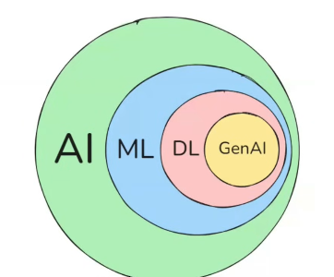

π
AI ML DeepLearning GenAI
July 2025
π

Slide 2
π
AI- Artificial Intelligence
ML- Machine learning
DL- Deep Learning
What is model in machine learning
Context Window
AI-Artificial Intelligence
AI-Artificial Intelligence
AI-Artificial Intelligence
AI-Artificial Intelligence
Notes:
Content: https://www.linkedin.com/pulse/chunking-strategies-ai-data-kash-kashyap-0lghe/

Slide 3
π
AI
Artificial Intelligence
Artificial Intelligence is about making machines intelligent.
it means making think like human.
Chatbot
e.g.
Self driving car
AI- Build Application that do require human intervention
Example -
Self Driving Card
Human Robot
Notes:
Content: https://www.linkedin.com/pulse/chunking-strategies-ai-data-kash-kashyap-0lghe/

Slide 4
π
AI Engineer
AI Product
Notes:
Content: https://www.linkedin.com/pulse/chunking-strategies-ai-data-kash-kashyap-0lghe/

Slide 5
π
ML –Machine Learning
Machine Learning is just a part of AI.it is a subset of AI.
we can say it is a way to achieve AI
to make machine think like human, we need to make them learn from data whatever we have without explicit any coding
so the process of making machines to learn from data whatever we have is called machine Learning
Netflix recommendation
e.g.
Spam Email filtering
Notes:
Content: https://www.linkedin.com/pulse/chunking-strategies-ai-data-kash-kashyap-0lghe/

Slide 6
π
Machine learning
- pattern
- classification
- prediction(raining)
forecasting
statistical Analysis
(-To understand the data)
Notes:
Content: https://www.linkedin.com/pulse/chunking-strategies-ai-data-kash-kashyap-0lghe/

Slide 7
π
Whenever we talk about deep learning, we are talking to an advancement where we do not just try to find patterns in data, but use that data to mimic the human brain.
Deep learning
Mimic the human brain
This is also not very advanced
Computer vision
(- Image, video, visual things)
NLP
(textual data thing)
- Next word prediction( google)
- Sentiment (twitter)
Discriminative AI
Notes:
Content: https://www.linkedin.com/pulse/chunking-strategies-ai-data-kash-kashyap-0lghe/

Slide 8
π
GenAI
Generative the text, image Video
Train on large amount of data like Whole internet data
Foundation Model
LLM
Textual
Open Ai
Gemini
ollama
Diffusion
Image, Video
Open Source
Paid Version
Notes:
Content: https://www.linkedin.com/pulse/chunking-strategies-ai-data-kash-kashyap-0lghe/

Slide 9
OpenAI
Gemini
Large
language
Model
oLlama
LLM
midjourney
AI
ML
DL
GenAI
Diff
Dall-E
Diffusion
Model
Stable
Diffusion
Notes:
Content: https://www.linkedin.com/pulse/chunking-strategies-ai-data-kash-kashyap-0lghe/

Slide 10
π
Deep Learning
Deep learning is again a subset of machine learning.
Here we try to mimic how our brains work means how neurons work in our brain
Here we have artificial neutrals network because of so many layering in our brain.
Our brain is very complex and very deep that's why we called it deep learning
Deep Learning use neural network which train on large dataset and complex problem
To solve below problems
Image recognition
e.g.
speech translation
Deep Learning is all about neural network
Notes:
Content: https://www.linkedin.com/pulse/chunking-strategies-ai-data-kash-kashyap-0lghe/

Slide 11
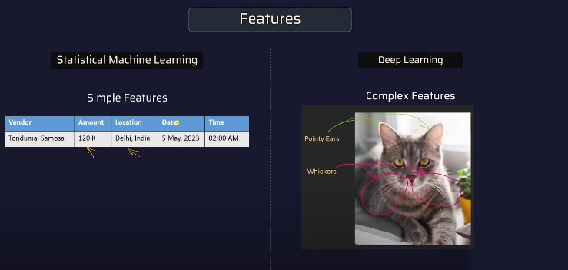
π
NOTE
When features are complex we use Deep learning and when features are simple, we use Machine Learning(Statistical Machine Learning)
Notes:
Content: https://www.linkedin.com/pulse/chunking-strategies-ai-data-kash-kashyap-0lghe/

Slide 12
π
What is model in machine learning
machine need some data to learn the pattern
approach of learning the pattern is algorithm for particular learning
Size of house | Cost of house
1200 | 80 L
1400 | 90 L
Data
1350
?
Once Pattern has been learned using data. If i ask to machine what is cost of house for 1350 size. From the learned pattern machine should be able to answer the cost of price .
85L
Notes:
Content: https://www.linkedin.com/pulse/chunking-strategies-ai-data-kash-kashyap-0lghe/

Slide 13
π
machine learning is a process where machine learns pattern using data and some algorithm and produces something that is called Model
Model is a entity which has learned pattern from data using algorithm
Notes:
Content: https://www.linkedin.com/pulse/chunking-strategies-ai-data-kash-kashyap-0lghe/

Slide 14
π
Notes:
Content: https://www.linkedin.com/pulse/chunking-strategies-ai-data-kash-kashyap-0lghe/

